Slide 2
Housekeeping Reminders
Thank you to the Surgical Infection Society for allowing us to present this Breakfast Symposium
Thank you to Tetraphase Pharmaceuticals for their unrestricted educational grant in support of this program.
As a reminder, this program is not accredited by SIS. To receive credit, please complete your CME Program Form or see instructions in the program booklet.
Also, please make sure to check in for this session.

Slide 3
Disclosures
This information can be found in the Program Book
The faculty and planners for this program disclose the following:
Philip S. Barie, MD, MBA, Master CCM, FIDSA, FACS
Member Speakers Bureau: Actavis, Pfizer, Irrimax
Advisory Board Member: Actavis, Cubist, Irrimax
David Nicolau, PharmD, FCCP, FIDSA
Consultant, Member Speakers Bureau or Grants Received: AstraZeneca, Cubist, Merck, Pfizer, Tetraphase, Bayer, Melinta Therapeutics
Joseph Solomkin, MD, FIDSA, FACS
Consultant/Advisor: Cubist, AstraZeneca, Merck, Pfizer, Tetraphase, Bayer, Theravance
MedEDirect planners and reviewers have nothing to disclose.
Scientific Integrity and Disclosure of Financial Interests:
MedEDirect requires that all CE/CME information be based on the application of research findings and the implementation of evidence-based medicine. MedEDirect promotes balance, objectivity, and absence of bias in its content. All persons in a position to control the content of this activity must disclose any conflicts of interest. MedEDirect has mechanisms in place to resolve all conflicts of interest prior to an educational activity being delivered to the learners.

Slide 4
Agenda
7:00 am – 7:20 am
Epidemiology and Clinical Impact of Gram-negative Infections
Philip S. Barie, MD, MBA
7:20 am – 7:40 am
Approaches to Drug/Dose Optimization
David P. Nicolau, PharmD, FCCP, FIDSA
7:40 am – 8:00 am
Update on Treatment Options for Gram-negative Pathogens
Joseph Solomkin, MD

Slide 5
Learning Objectives
Describe the scope, prevalence, and clinical implications of resistant gram-negative pathogen infections
Outline how PK/PD parameters impact drug/dose optimization
List currently available and pipeline treatment options for gram-negative infections and how these drugs may be useful for optimal antibiotic therapy in clinical practice

Slide 6
Epidemiology and Clinical Impact of Gram-negative pathogens
Philip S. Barie, MD, MBA
Professor of Surgery
Professor of Public Health in Medicine
Weill Cornell Medical College
Attending Surgeon
New York–Presbyterian Hospital/Weill Cornell Medical Center
New York, NY

Slide 7
Overview
Describe the scope, prevalence, and clinical implications of resistant gram-negative pathogen infections
Understand definitions
Review the epidemiology
Understand associated outcomes

Slide 8
EPIC II
Point prevalence study
International ICUs (n=1,265)
  Population: 13,796 patients; 51% infected
Cohort
  Mean SOFA score: 6.3
  28% medical, 72% surgery/trauma
  56% on mechanical ventilation
Vincent JA, et al. JAMA 2009; 302: 2323-9.

Slide 9
Sites of Infection-EPIC II
No. (%)ª
Site of Infection | All | North America | Western Europe | Eastern Europe | Central/ South America | Oceania | Africa | Asia
No. (%) | 7087 (51.4) | 607 (48.4) | 3683 (49) | 426 (56.4) | 1290 (60.3) | 285 (48.2) | 89 (46.1) | 707 (52.6)
Respiratory tract | 4503 (63.5) | 345 (56.8) | 2332 (63.3) | 305 (71.6)^{b} | 851 (66) | 165 (57.9) | 41 (46.1)^{b} | 464 (6 5.6)
Abdominal | 1392 (19.6) | 101 (16.6) | 778 (21.1) | 93 (21.8) | 228 (17.7)^{b} | 50 (17.5) | 16 (18) | 126 (17.8)
Blood stream | 1071 (15.1) | 157 (25.9) | 546 (14.8) | 53 (12.4) | 139 (10.8)^{b} | 49 (17.2) | 16 (18) | 111 (15.7)
Renal/urinary tract | 1011 (14.3) | 135 (22.2) | 411 (11.2) | 84 (19.7)^{b} | 222 (17.2)^{b} | 33 (11.6) | 15 (16.9) | 111 (15.7)^{b}
Skin | 467 (6.6) | 26 ( 4.3) | 242 (6.6) | 37 (8.7) | 73 (5.7) | 30 (10.5) | 8 (9.0) | 51 (7.2)
Catheter- related | 332 (4.7) | 16 (2.6) | 171 (4.6) | 21 (4.9) | 73 (5.7) | 15 (5.3) | 4 (4.5) | 32 (4.5)
CNS | 208 (2.9) | 14 ( 2.3) | 100 (2.7) | 20 (4.7) | 40 (3.1) | 11 (3.9) | 4 (4.5) | 19 (2.7)
Others | 540 (7.6) | 62 (10.2) | 289 (7.8) | 31 (7.3) | 87 (6.7) | 22 (7.7) | 14 (15.7)^{b} | 35 (5.0)^{b}
Vincent JA, et al. JAMA 2009; 302: 2323-9.

Slide 10
GNB Pathogens-EPIC II
No. (%)ª
 | All | North America | Western Europe | Eastern Europe | Central/ South America | Oceania | Africa | Asia
Gram-negative | 3077 (62.2) | 228 (49.9) | 1573 (58.7) | 258 (72.3)^{b} | 510 (70.9)^{b} | 122 (59.8) | 31 (57.4) | 355 (74.3)^{b}
Escherichia coli | 792 (16.0) | 65 (14.2) | 458 (17.1) | 53 (14.8) | 103 (14.3) | 27 (13.2) | 6 (11.1) | 80 (16.7)
Enterobacter | 345 (7.0) | 37 ( 8.1) | 184 (6.9) | 29 (8.1) | 62 (8.6) | 7 (3.4) | 4 (7.4) | 22 (4.6)
Klebsiella species | 627 (12.7) | 41 ( 9.0) | 261 (9.7) | 76 (21.3)^{b} | 116 (16.1)^{b} | 24 (11.8) | 10 (18.5) | 99 (20.7)^{b}
Pseudomonas species | 984 (19.9) | 59 (12.9) | 458 (17.1) | 103 (28.9)^{b} | 189 (26.3)^{b} | 30 (14.7) | 8 (14.8) | 137 (28.7)^{b}
Acnetobacter species | 435 (8.8) | 17 ( 3.7) | 149 (5.6) | 61 (17.1)^{b} | 99 (13.8)^{b} | 9 (4.4) | 8 (14.8)^{b} | 92 (19.2)^{b}
Other | 840 (17.0) | 52 (11.4) | 487 (18.2) | 54 (15.1) | 121 (16.8) | 42 (20.6) | 11 (20.4) | 73 (15.3)
ESBL-producing | 93 (1.9) | 1 ( 0.2) | 47 (1.8) | 7 (2.0) | 21 (2.9) | 0 | 1 (1.9) | 16 (3.3)
Vincent JA, et al. JAMA 2009; 302: 2323-9.

Slide 11
Globally, the Majority of ICU infections Are Due to Gram-Negative Bacteria
70% of infected patients had positive cultures; 62% were gram-negative
31% of gram-negative cultures were Pseudomonas spp.
Pseudomonas spp.
Escherichia
coli
Klebsiella
spp.
Acinetobacter
spp.
Enterobacter
spp.
Other
Data from the Extended Prevalence of Infection in Intensive Care (EPIC II) Study, a global,
1-day point prevalence study of 13,796 patients from 1,265 ICUs in 75 countries in 2007.
Vincent et al. JAMA. 2009;302:2323-9.

Slide 12
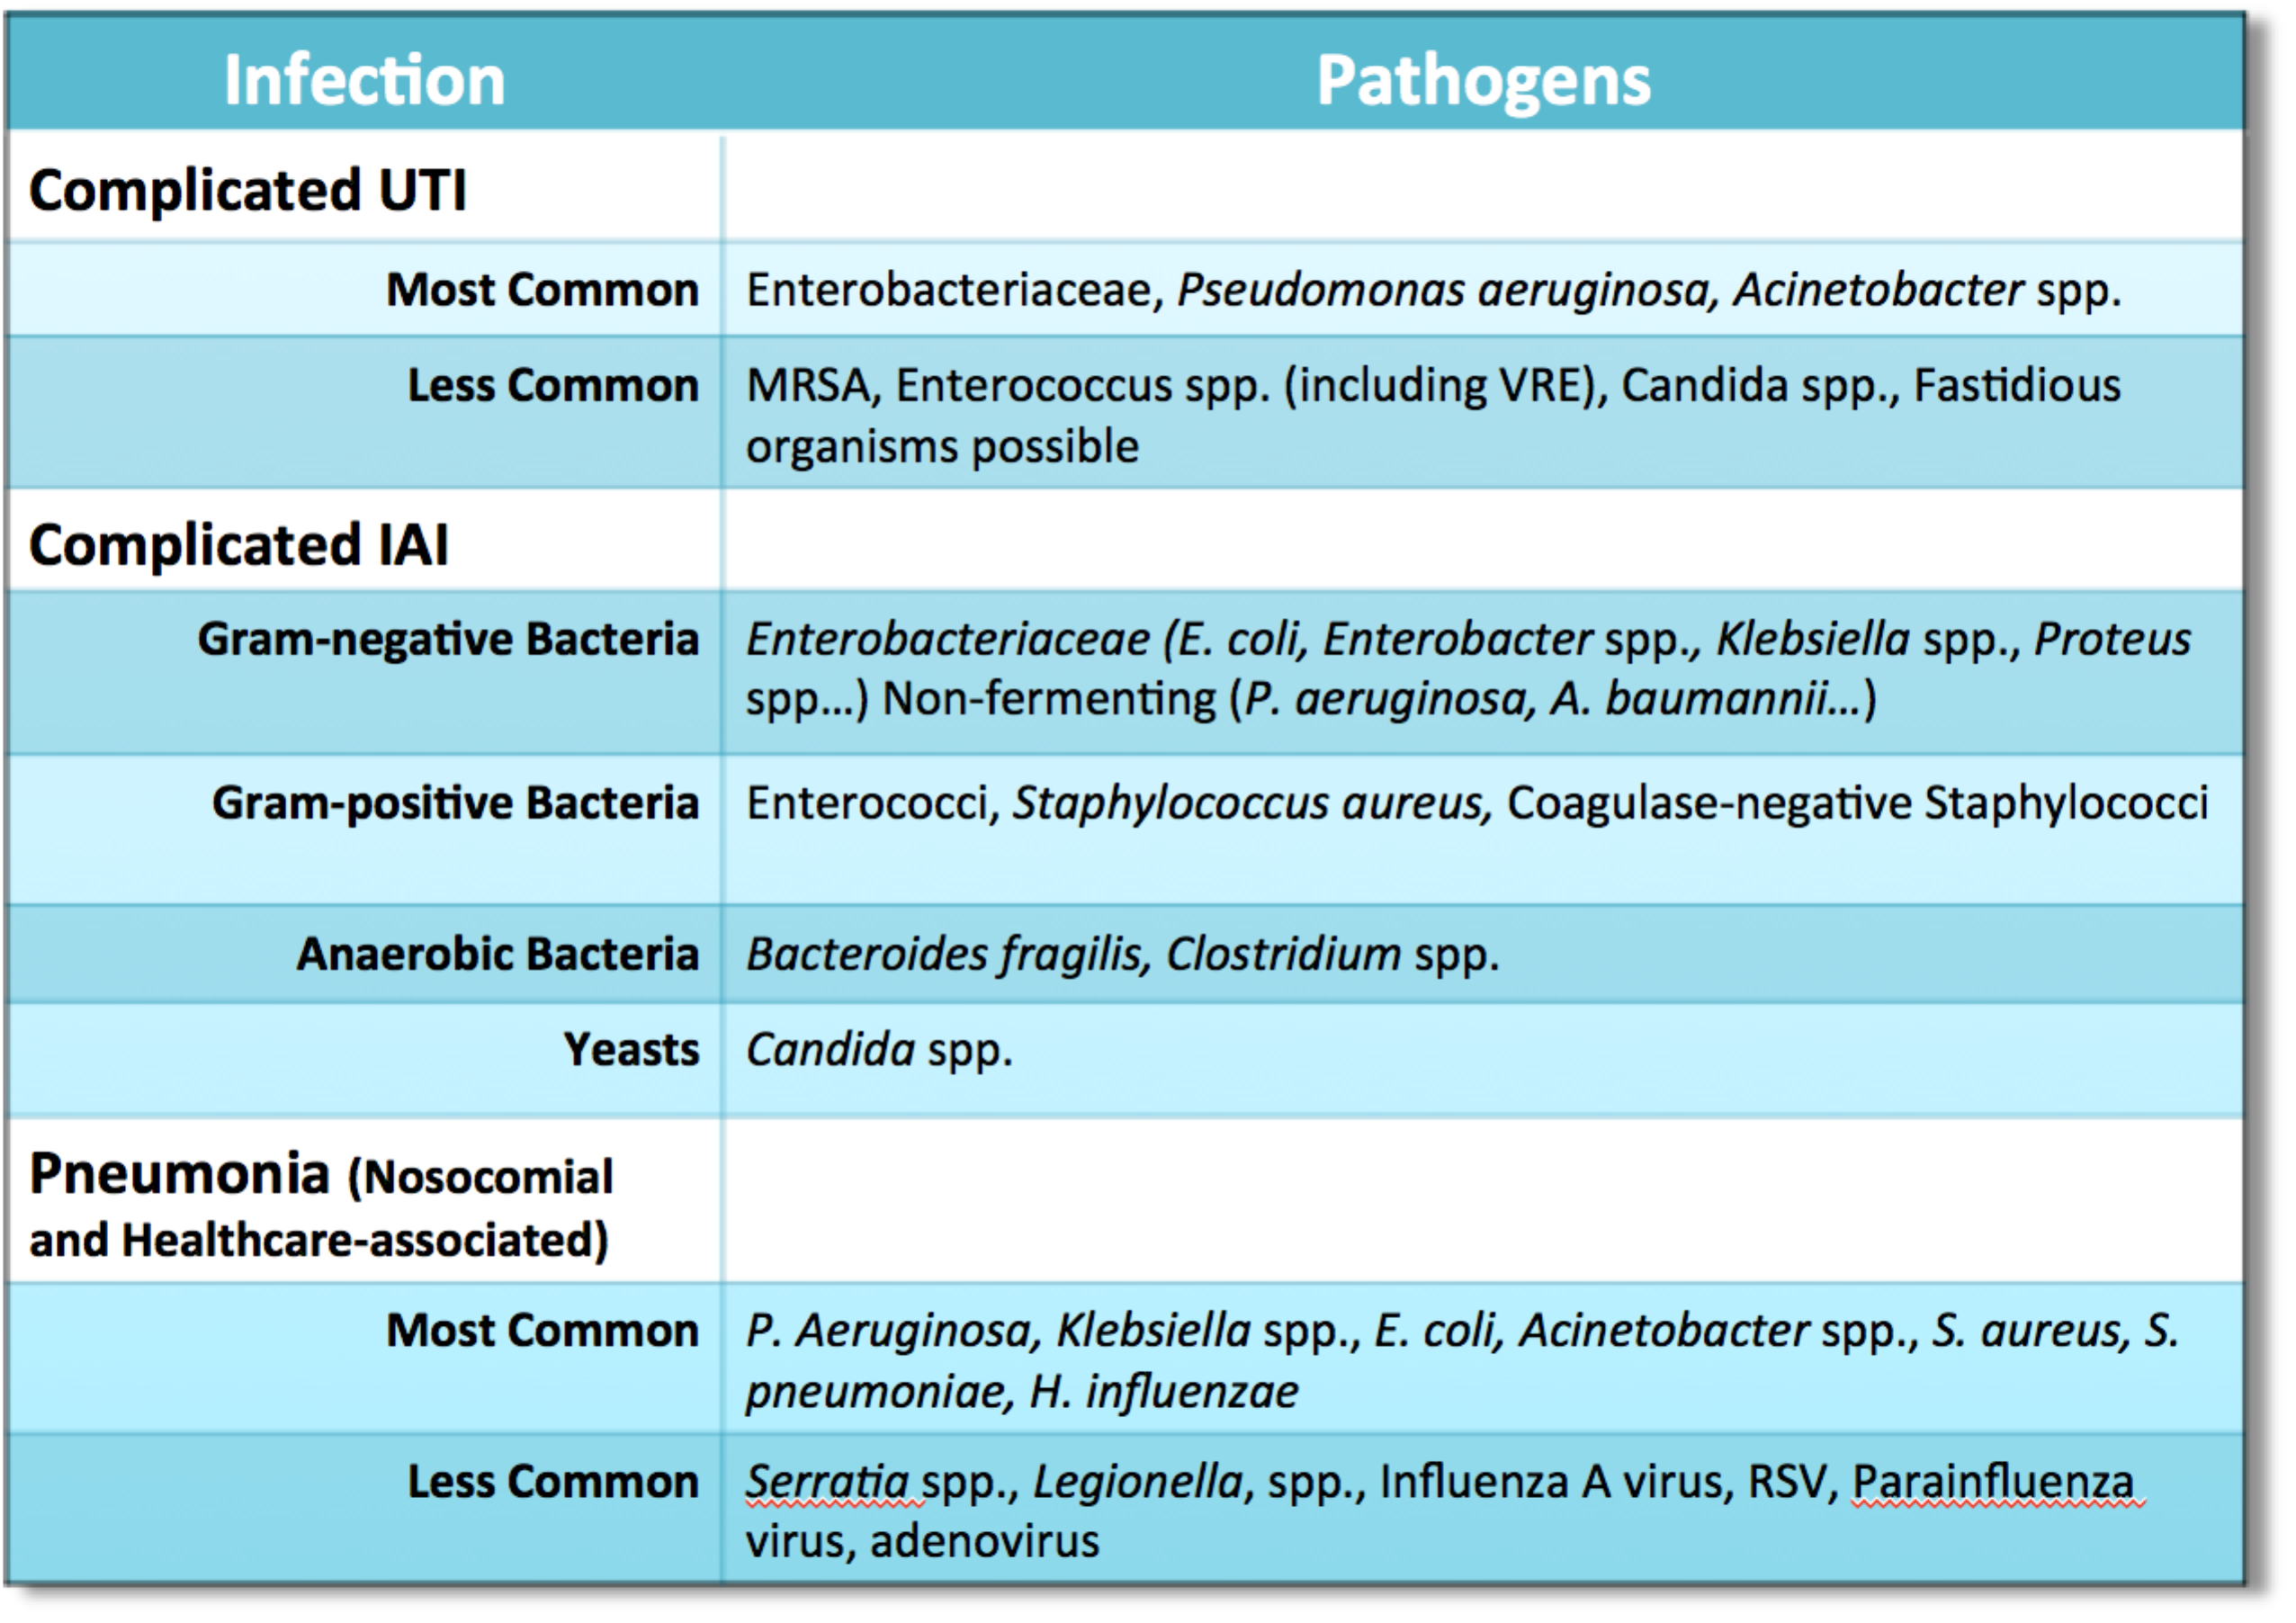
Organisms by Infection Type

Slide 13
Emergence and Impact of MDR Gram-Negative Organisms
Approximately 10% of hospitalizations are complicated by a healthcare-associated Infection
  Up to 75% of these are due to organisms resistant to first-line antimicrobial therapy
Resistant bacterial infections are associated with increased morbidity, mortality, and healthcare cost
There has been a recent dramatic increase in the prevalence of resistant gram-negative bacteria
  ESBL-producing Enterobacteriaceae
  Carbapenem-resistant Enterobacteriaceae
  MDR Pseudomonas aeruginosa
  MDR Acinetobacter baumannii
Lautenbach E, et al. Infect Control Hosp Epidemiol; 2014;35(4): 333-335.

Slide 14
SO HOW DID WE
GET HERE?

Slide 15
Evolution of Gram-negative Pathogens Has Caused Widespread Drug Resistance
Susceptible
gram-negative pathogens
Resistant Escherichia coli
TEM
SHV serine
β-lactamases
Resistant E. coli, Pseudomonas aeruginosa and Klebsiella spp.
AcrAB
bla_{SHV}
bla_{TEM}
AmpC-type
β-lactamases
1960s
Ampicillin
Resistant E. coli,
P. aeruginosa, Klebsiella spp., Enterobacter spp.
CTX-M-15
VIM
IMP
NDM-1
Porin defects
Metallo β-lactamases
1980s
Cephalosporins
Fluoroquinolones (1990s)
Hawkey. Antimicrob Chemother. 2008;62:i1-9.
Hawkey and Jones. J Antimicrob Chemother. 2009;64:i3-10.
Bush. Antimicrob. Agents Chemother. 2010;54:969-76.
Livermore. Clin Infect Dis. 2002;34:634-40.
Olivares et al. Front Microbiol. 2013;4:103.
2000s
Carbapenems

Slide 16
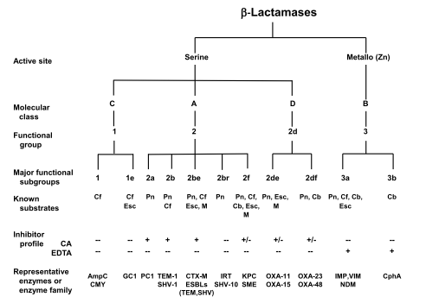
Classification of Beta-Lactamases
Bush. Ann N Y Acad Sci 2013;1277: 84–90.

Slide 17
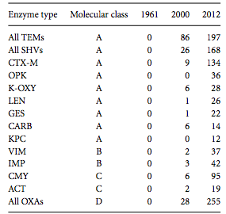
Proliferation of Beta-Lactamases
Bush. Ann N Y Acad Sci 2013;1277: 84–90.

Slide 18
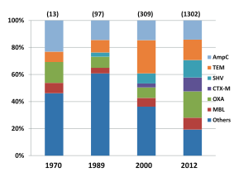
Frequency of Beta-Lactamases
Bush. Ann N Y Acad Sci 2013;1277: 84–90

Slide 19
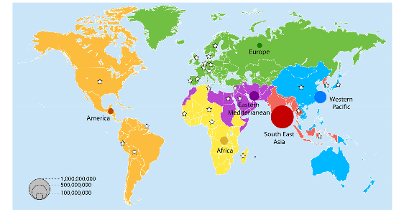
ESBL Carriers in the Community, 2010
Woerther et al. Clin Microbiol Rev 2013;26:744-758.

Slide 20
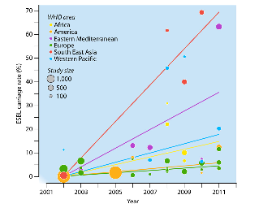
Increasing Global ESBL Carriage Rates in Feces, 2001-2011
Woerther et al. Clin Microbiol Rev 2013;26:744-758.

Slide 21
Important Classes of Resistance
A wide variety of resistance mechanisms are described in gram-negative bacteria
  Some mechanisms i.e. ESBL production overlap species
  Others are highly specific
Definitions developed specifically for public health and epidemiology purposes
  Organism designated as nonsusceptible when it tested intermediate or resistant using clinical breakpoints as interpretive criteria
  Only acquired resistance was considered, thus intrinsic species-wide resistance to specific antimicrobial agents was not considered in defining classes of resistance.
Fraimow H, et al. Crit Care Clin 2013; 29: 895-21.

Slide 22
Defining Resistance in GNB
The antimicrobial categories and breakpoints for determining nonsusceptibility are individually defined for each clinically important class of GNB
Fraimow H, et al. Crit Care Clin 2013; 29: 895-21.

Slide 23
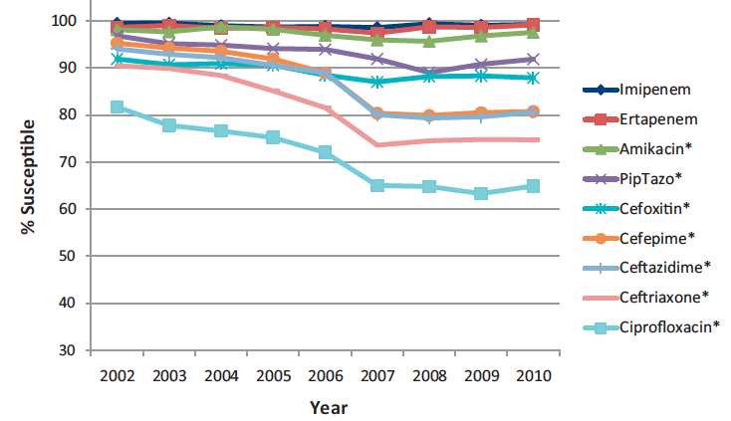
Global Susceptibility of E. coli from cIAI, 2002-2010 (30,840 isolates)
Hawser et al. Int J Antimicrob Agents 2013;41:224-228.

Slide 24
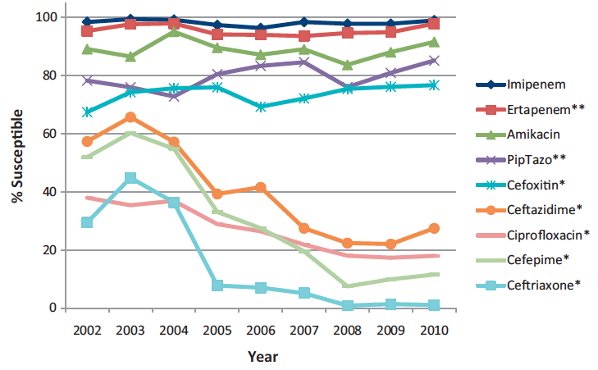
Global Susceptibility of ESBL-E. coli from cIAI, 2002-2010 (5,525 isolates)
* Decreased p<0.05
** Increased p<0.05
Hawser et al. Int J Antimicrob Agents 2013;41:224-228.

Slide 25
Susceptibilities of Klebsiella pneumoniae IAI isolates
2,841 clinical isolates collected by SMART
ESBL production 22.4%
Region | Number of Isolates
 | Total | ESBL - | ESBL + | % ESBL +
Global | 2,841 | 2,204 | 637 | 22.4%
Latin America | 410 | 268 | 142 | 34.6%
Africa | 31 | 21 | 10 | 32.2%
Asia | 1,013 | 754 | 259 | 22.6
Middle East | 62 | 48 | 14 | 22.6%
Europe | 671 | 539 | 132 | 19.7%
South Pacific | 154 | 124 | 30 | 19/5%
North America | 500 | 450 | 50 | 10.0%
Hawser et al. Antimicrob Agents Chemother 2011;3917-3921.

Slide 26
Trends in Bacterial Susceptibility, North America 2006-2012
Yearly Prevalence of Key Resistance Phenotypes in the United States
P<0.001
Prevalence (% of isolates tested)
P<0.001
P<0.001
P<0.001
P=0.001
The chi-square test for trend was applied using the EPI Info 7 statistical package. P values of <0.05 were considered significant.
Sader et al. Antimicrob Agents Chemother 2014;58:2274-2280.

Slide 27
Risk Factors For Bacteremia Due to ESBL-Producing Enterobacteriaceae
 | OR (95% CI)
Risk factor | Entire series | E. coli or Klebsiella spp. series
Source of infection |  | –
Unknown | Comparison group
Urinary tract | 4.17 (2.22-7.84)
Shock on presentation | 2.35 (1.35-4.1) | –
Prior ESBL-E isolation | 5.88 (3.02-11.5) | 4.53 (2.09-0.83)
Ultimately/finally fatal underlying disease | 2.77 (1.55-4.95) | 2.9 (1.57-5.37)
Renal transplantation | 4.34 (1.96-9.63) | 6.97 (2.67-18.2)
Prior cephalosporins | 2.64 (1.54-4.51) | 4.24 (2.26-7.96)
Prior carbapenems | 2.5 (1.24-5.05) | 2.92 (1.27-6.72)
Prior glycopeptides | 0.35 (0.13-0.93)
Hospital-acquired infection | – | 1.88 (1.08-3.33)
Martínez JA, et al. J Antimicrob Chemother. 2006;58:1082-1085.

Slide 28
Carbapenem-resistant K. pneumoniae
Multivariable analysis of risk factors for emergence
Parameter | Odds ratio | 95% C.I. | p
Prior fluoroquinolone use | 1.87 | 1.07-3.26 | 0.026
Prior carbapenem use | 1.83 | 1.02-3.27 | 0.042
ICU admission | 4.27 | 2.49-7.31 | >0.001
Exposure to at least 1 antibiotic prior to isolation of K. pneumoniae | 1.02 | 1.00-1.03 | 0.012
Hussein K, et al. Infect Control Hosp Epidemiol. 2009;30:666-671.

Slide 29
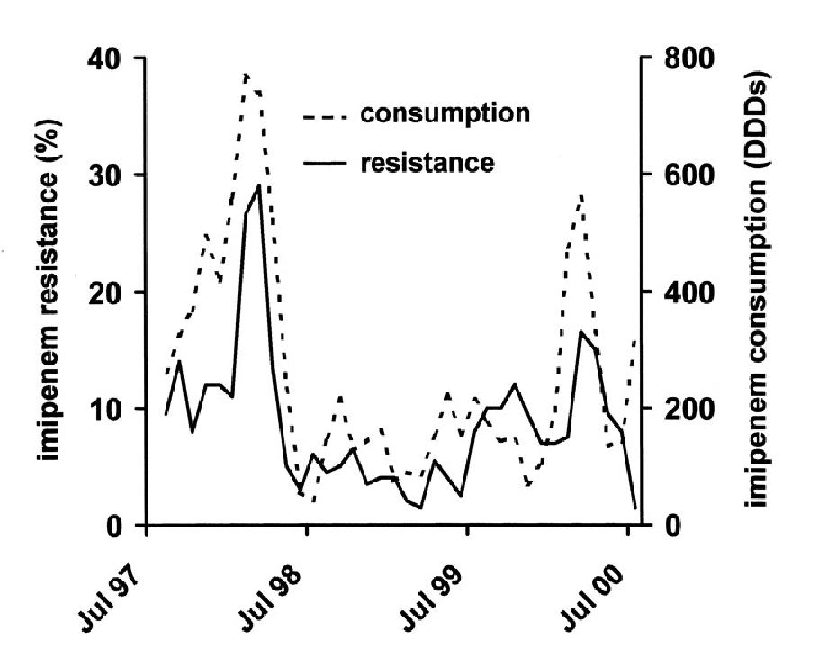
Correlation Between Carbapenem Consumption and P. aeruginosa Resistance
Carbapenem resistance (%)
Carbapenem consumption (DDDs)
Lepper PM, et al. Antimicrob Agents Chemother. 2002;46:2920-2925.

Slide 30
Antimicrobial Overuse in the ICU?
Only about 30% of all antibiotics are used for definitive therapy in which the susceptibility patterns for the infection-associated pathogen are known.
Steinman MA, et al. Ann Intern Med 2003
Fishman N. Am J Med 2006
Lawrence KL, Kollef M Am J Respir Crit Care Med 2009

Slide 31
Outcomes:
Predictors in GNB Septic Shock
Predictors of Hospital Mortality
Retrospective analysis
Subjects: GNB bacteremia causing septic shock
N=1,064
  E. coli: 27%
  K. pneumoniae: 20%
  P. aeruginosa: 17%
Endpoint: Mortality
IATT = Initial Appropriate Antimicrobial Therapy
Zilberberg MD, et al. Crit Care Med 2014. 18: 596.

Slide 32
Resistance and Outcomes
Independent Predictors of Mortality*
Independent Predictors of Inappropriate Therapy**
Variable | Corrected Risk Ratio | 95% CI | p
Inappropriate therapy | 1.42 | 1.10-1.58 | 0.015
APACHE II | 1.06 | 1.03-1.09 | 0.001
Primary bacteremia source: Urine | 0.40 | 0.16-0.87 | 0.018
Variable | Corrected Risk Ratio | 95% CI | p
CRAB | 2.66 | 2.43-2.72 | 0.001
CHF | 1.89 | 1.01-2.63 | 0.048
**AUROC: 0.88
*AUROC: 0.81
Shorr AF, et al. BMC ID 2014: 14; 572

Slide 33
Inappropriate Therapy: A Modifiable Risk Factor
Predictors of Receiving Initially Inappropriate Antibiotic Therapy

Slide 34
Appropriate Therapy and Mortality in AB Bacteremia and Shock
Single, center retrospective cohort
Subjects: AB Bacteremia (primary or secondary) with septic shock
Endpoint: Hospital mortality
n=131
58% Carbapenem-resistant
Acinetobacter baumannii (CRAB)
Crude mortality: 50%
Variable | Died (n=65) | Survived (n=66) | p
CRAB | 69% | 47% | 0.010
Initially Inappropriate Therapy | 83% | 59% | 0.001
Median LOS in patients with AB Bacteremia: 9 days
Shorr AF, et al. BMC ID 2014: 14; 572

Slide 35
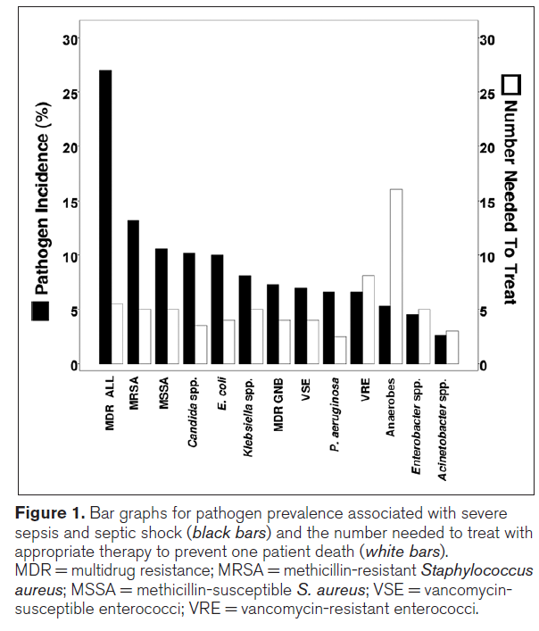
Impact of Resistance on Outcomes:
How Many Times Do We Have to Get it Right to Save One Life?
Retrospective analysis of impact of appropriate therapy on mortality
1,250 subjects with septic shock
Inappropriate antibiotics: 3.4 x independent increase in risk for death
NNT calculated per pathogen
Every 5 patients given appropriate therapy yielded one additional survivor!
Vazquez-Guillamet C, et al. Crit Care Med 2014; 42: 2342-2349.

Slide 36
Where Does Resistance Fit In?
Resistance in selected clinical pathogens has reached alarming rates
  Moreso in Asia, Africa, Latin America
  Hospital-acquired cIAI requires broad-spectrum Rx
  Consider for high-risk community-acquired cIAI
    FEW studies (big opportunity…)
Bacterial resistance exerts a major impact on clinical outcomes
Few new antimicrobials on the horizon with activity against MDR gram-negative pathogens
We MUST learn to use responsibly what we have while new agents are developed

Slide 37
Approaches to Drug/Dose Optimization
David P. Nicolau, PharmD, FCCP, FIDSA
Director
Center for Anti-Infective Research and Development
Hartford Hospital
Hartford, CT

Slide 38
Improving the Probability of
Positive Outcomes
IMPROVING THE ODDS
HOST
BUG
DRUG
Nicolau DP Am J Man Care 1998:4(10 Suppl) S525-30

Slide 39
Mortality Associated with Appropriate Therapy in Patients with Serious Infections
    When “S” Does NOT = Success
Rello et al
Why do we see continued Mortality?
Continuation of terminal process
Delay in the initiation of therapy
Inadequate dose / exposure
Alvarez-Lerma
Ibrahim et al
    - Augmented renal function
    - ↑ volume of distribution (sepsis / septic shock)
    - Impact of obesity
    → Reduced tissue concentrations (i.e., bronchopulmonary → ELF)
Luna et al
Garnacho-Montero et al
Vallés et al
0
20
40
60
80
100
Mortality (%)
  Rello et al. Am J Respir Crit Care Med 1997;156:196–200; Alvarez-Lerma. Intensive Care Med 1996;22:387–394
  Ibrahim et al. Chest 2000;118:146–155; Luna et al. Chest 1997;111:676–685
  Garnacho-Montero et al. Crit Care Med 2003;31:2742–2751; Vallés et al. Chest 2003;123:1615–1624

Slide 40
Do We Deliver Effective Doses in
Critically Ill Patients: Empiric Therapy
Pharmacodynamic goal not achieved in 16/19 (84%)
  8/16 (50%): organism resistant to empiric therapy
8/16 (50%): organism susceptible..but therapy not optimal
  6/8 organisms had MIC’s at the breakpoint
  2/8 organisms had MIC’s 1 dilution below the breakpoint
Mohr JF, et al. Diagn Micro Infect Dis 2004;48:125-30.

Slide 41
DALI: Defining Antibiotic Levels in Intensive Care Unit Patients
Prospective, multinational pharmacokinetic point-prevalence study including 8 β-lactam antibiotics¹
  248 patients treated for infection, 16% did not achieve 50% fT>MIC and these patients were 32% less likely to have a positive clinical outcome (odds ratio [OR], 0.68; P = .009).
  Positive clinical outcome was associated with increasing 50% fT>MIC and 100% f T>MIC ratios
42 patients from 26 ICUs receiving vancomycin²
  Target trough concentrations were achieved in 57% of patients, but more frequently in patients receiving continuous infusion (71% v. 39%; P = 0.038)
PK variability and exposures of fluconazole, anidulafungin, and caspofungin³
  33% receiving fluconazole did not attain the PD target of fAUC/MIC
¹Roberts JA et al. Clin Infect Dis 2014;58(8):1072-83
²Blot S et al. Crit Care. 2014;18(3):R99
³Sinnollareddy MG et al. Crit Care. 2015;19(1):758

Slide 42
Assessment of In Vitro Potency
Impact of Mechanism
Efflux ± Porin; Target site mutation
Pharmacodynamic dose optimization
CAN overcome higher MICs
Bacterial Population
S
I
R
Low
MIC (µg/mL)
High
S = Susceptible, I = Intermediate, R = Resistant

Slide 43
β-Lactam Antimicrobials:
The Backbone of Therapy
Penicillins, Cephalosporins, Carbapenems
± β-Lactamase inhibitor combinations
Most frequently used agents in hospital
Used to treat wide range of severity of illness: Sepsis → Urinary tract infections
Considerations for use:
  In vitro potency → Gram+, Gram- and anaerobic
  Clinical efficacy → Sepsis, Pneumonia, Urinary, …
  Safety profile → Well established
  Flexibility in dosing → Dose, Dosing Interval, Duration of Administration

Slide 44
Tying in Drug Potency to Antimicrobial Exposure = Pharmacodynamics
Concentration
β-Lactams
T>MIC
MIC
0
Time (hours)
MIC = minimum inhibitory concentration; AUC = area under the curve; T = time

Slide 45
Optimizing β-lactam Therapy: Maximizing Percent T>MIC
Other dosing strategies to improve T> MIC
Increased duration of infusion
  Continuous infusion
    Administer loading dose, then use pump to give total daily dose IV over 24 hr period
  Prolonged infusion
    Same dose and dosing interval, however, change duration of infusion (0.5 hr → 3hr)
  Infusion Strategies PLUS Higher Doses

Slide 46
Optimizing β-lactam Therapy:
Maximizing Percent T>MIC
Increased duration of infusion
  Prolonged infusion
    Same dose and dosing interval, 100-250ml, however, change duration of infusion (0.5 hr → 3-4hr)
32
16
8
Concentration
(mg/L)
4
MIC
2
1
0
2
4
6
8
10
12
Time Since Start of Infusion (h)

Slide 47
Assessing Antimicrobial Potency:
Beyond the “S”
MIC Distribution for P. aeruginosa from 40 U.S. Hospitals (n= 1044)
40
35
Meropenem
“S” Breakpoint 2012
30
25
20
Percentage of Isolates
15
10
5
0
0.01
0.02
0.03
0.06
0.13
0.25
0.5
1
2
4
8
16
32
64
128
256
Eagye KJ et al, Clin Ther 2009;31(11):2678-2688
MIC (μg/ml)

Slide 48
Hartford Hospital:
VAP Pathway – EMPIRIC Therapy
1st Line Regimen: | Dosage (CrCl ≥ 50ml/min) | Adjustment for Renal Dysfunction (CrCL in ml/min)
 |  | 30 - 49 | < 30 | CRRT
Vancomycin (Linezolid) plus | Dosing per Pharmacy Protocol (High Dose)
Tobramycin plus | Dosing per Once Daily Aminoglycoside Protocol
High Dose β-lactam
Target entire MIC distribution
Anticipate variable PK → Cl & Vd
Target PD profile → fT>MIC
Medical Intensive Care Unit
Meropenem | 2g q 8 hr (3 hr infusion)
Surgical and Neurosurgical Intensive Care Unit
Cefepime Piperacillin / Tazobactam | 2g q 8 hr (3 hr infusion) 18g continuous inf
CI = continuous infusion; CRRT = continuous renal replacement therapy
Nicasio AM, et al. J Crit Care 2010;25:69-77; Kuti & Nicolau J Crit Care 2010;25:152-153

Slide 49
Improved Outcomes: VAP Pathway
Outcome | Historic n = 74
Days to AAT (mean ± SD) | 1.7 ± 2.6
AAT within 24 hrs | 36 (48.6)
LOS (mean ± SD)
IR | 26.1 ± 18.5
ICU | 31.9 ± 19.9
Hospital | 43.3 ± 23.6
Superinfection | 26 (35.1)
MDR-Superinfection | 20 (27.0)
All Cause Mortality | 26 (35.1)
IR-Mortality | 16 (21.6)
 |  | Pathway n = 94 | P-value
 |  | 0.8 ± 0.8 | 0.065
 |  | 53 (71.6) | 0.007
 |  | 11.7 ± 8.1 | <0.001
 |  | 29.0 ± 18.6 | 0.282
 |  | 37.9 ± 20.1 | 0.113
 |  | 15 (16.0) | 0.007
 |  | 9 (9.6) | 0.006
 |  | 27 (28.7) | 0.471
 |  | 8 (8.5) | 0.029
The Pathway Statistically** Decreased:
Infection Related Mortality**
Infection Related Length of Stay**
Time to Appropriate Therapy**
Number of Super-infections**
Enhanced effectiveness of β-lactams for High MIC P. aeruginosa
AAT = Appropriate Antibiotic Therapy, LOS = Length of Stay
IR = Infection Related, MDR = Multi-Drug Resistant
Nicasio AM, et al. J Crit Care 2010;25:69-77

Slide 50
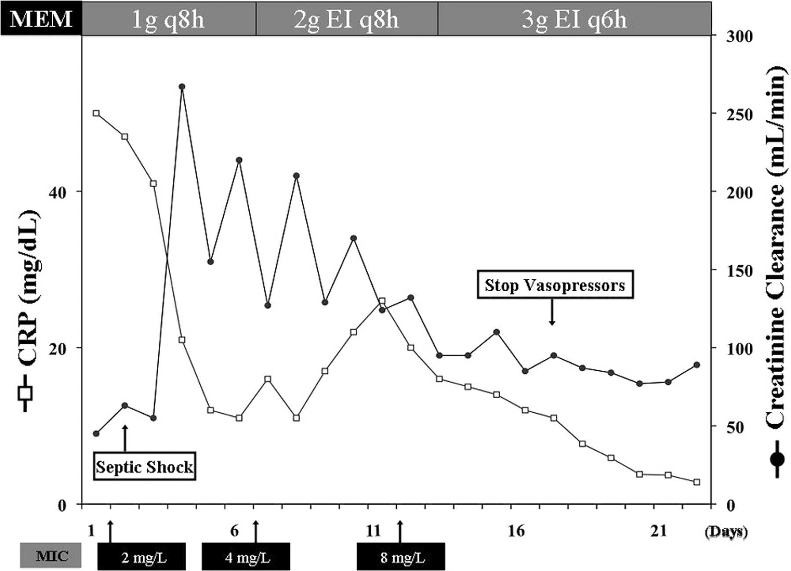
Optimal Meropenem Dosing to Treat MDR P. aeruginosa Septic Shock
Taccone F S et al. Antimicrob. Agents Chemother. 2012;56:2129-2131

Slide 51
Extended Infusion Cefepime for the Treatment of Invasive P. aeruginosa Infections
Respiratory & Blood isolates
Intermittent 1g q8h [n=51] v. Extended 2g q8h [n =35]
Extended infusion resulted in:
  Reduced LOS 18 vs. 12 days
  Reduced LOSICU 18 vs. 10 days
  Reduced Mortalityhospital 23 vs. 6%
  Reduced Mortailty14 day 20 vs. 3%
  Reduced Cost of Care $53,000 vs. $30,000 USD
Bauer KA, et al., Antimicrob Agents Chemo 2013;57(7):2907-2912

Slide 52
Antimicrobial Resistance in
Gram-negative bacilli
Resistance is a complex problem^{1,2}
  Expanding mechanisms
    Efflux pumps
    Permeability changes
    Target Site Mutations
Problematic β-lactamases³
  Amp C: resistance of all β-lactams except carbapenems
  ESBLs: resistance to oxyiminocephalosporins and monobactams
  Metallo-: resistance to all except monobactams
  Oxacillinase: resistance to carbapenems
  KPCs: resistance to all β-lactams
Multiple / concurrent mechanisms
1. Talbot GH, et al. Clin Infect Dis. 2006;42:657-68. 2. Bush K. Clin Infect Dis. 2001;32:1085-1089; 3. Rahal JJ. Clin Infect Dis. 2009; 49: S4-10

Slide 53
Problematic Gram-Negatives and Mechanisms of Resistance
Pseudomonas aeruginosa
  AmpC production, efflux pumps (MexAB-OprM, etc), outer membrane porin changes (i.e., loss of OprD), Metallo-Beta-Lactamase production (e.g., bla_{VIM}, bla_{IMP}), gyrA/parC mutations, aminoglycoside-modifying enzymes (AME), ESBL / KPC production
Acinetobacter species
  AmpC, ESBL (TEM-1, SHV-type, CTX-M-type), and serine (blaOXA) and metallo (blaVIM, blaIMP) carbapenemase production, outer membrane porin changes, AME, gyrA/parC mutations, efflux pumps
Enterobacteriaceae (Klebsiella species, E. coli, Enterobacter species)
  ESBL, Klebsiella-producing-carbapenemase (KPC-2, -3, -4, etc.) production, New Delhi Metallo-Beta-Lactamase (NDM-1, -2), AmpC, outer membrane porin changes, plasmid mediated quinolone resistance gene (qnrA)
Other multidrug resistant, non-fermentative bacteria
  Stenotrophomonas maltophilia, Burkholdheria cepacia complex
Bonomo RA, et al. Clin Infect Dis 2006;43:S49-56, Nicasio AM, et al. Pharmacotherapy 2008;28:235-49

Slide 54
Assessment of In Vitro Potency
Impact of Mechanism
Enzyme mediated
Pharmacodynamic dose optimization
WILL NOT overcome high MICs
Bacterial Population
S
I
R
Low
MIC (µg/mL)
High
S = Susceptible, I = Intermediate, R = Resistant

Slide 55
ESBL Producers Are Associated
With Higher Mortality
Meta-analysis of mortality from bacteremia with ESBL producers¹
  16 studies from 2000 to 2006
  Crude mortality 34% (199/591) for ESBL producers vs. 20% (216/1091) for non-ESBL
  Pooled RR 1.85; 95% CIs 1.39–2.47
Delay in effective therapy in up to 44% patients with ESBL producers^{1,2}
1. Schwaber et al. Presented at: 46th ICAAC; Sept 27-30, 2006; San Francisco, CA. Abstract K1521; 2. Goff et al. Presented at: 46th ICAAC; Sept 27-30, 2006; San Francisco, CA. Abstract K1520.

Slide 56
Appropriate Antimicrobial Therapy
An Increasing Challenge
Impact of ESBLs on Economic Outcomes in Patients with Urinary Tract Infection
  55 ESBL (cases) & matched controls (non-ESBL UTI)
    Failure of initial antibiotic → prolonged LOS (6 v. 4 days; P=0.02) in ESBL infected patients
    Median cost of care was greater (additional $3,658; P=0.02) in ESBLs infected patients
    Cost of care & LOS with ESBLs were 1.5 times those caused by non-ESBL UTIs → resulted in net hospital loss of $3,200 per ESBL UTI infection
    Antibiotic cost <1% of cost of care
MacVane SH, Tuttle LO, Nicolau DP. Journal of Hospital Medicine 20014:9(4);232-238
Notes:
56
Reference
Weber DJ. Collateral damage and what the future might hold. The need to balance prudent antibiotic utilization and stewardship with effective patient management. Int J Infect Dis. 2006;10(suppl 2):S17-S24.

Slide 57
Carbapenem Usage Continues to Rise Dramatically in the US
86%
increase
Carbapenem Days of Therapy (000s)
Utilization 2009-2015?
National Sales Perspective (NSP) Audit. IMS. December 2008.
Notes:
Carbapenem usage has continued to rise dramatically over the years
2003-2008. The graph indicates there has been an 86% increase in their usage during this time frame.
Source:
National Sales Perspective (NSP) Audit. IMS. December 2008.
57
IMS-NSP Chart
9079-4869
Divided by 4869 x100= 86.46%
S

Slide 58
Risk Factors for the Acquisition of Carbapenem-Resistant K. pneumoniae
CRKP isolated from 88 patients
Carbapenem-susceptible K. pneumoniae in 373 patients
#-fold increase in the risk of acquisition
P=0.026
P=0.042
P<0.001
P=0.029
Hussein K, et al. Infect Control Hosp Epidemiol. 2009;30:666-671.
Notes:
Hussein, 668A, 667B
Slide 54.
A multivariable analysis by Hussein et al. revealed that independent risk factors for infection with carbapenem-resistant K. pneumoniae included prior fluoroquinolone use (odds ratio (OR), 1.87), previous administration of a carbapenem (OR, 1.83), admission to the intensive care unit (OR, 4.27), and exposure to at least one antibiotic drug before the isolation of K. pneumoniae (OR, 3.93). [Hussein 2009 / 668A]
All antimicrobial therapy administered in the 90 days prior to the positive culture result were ascertained. [Hussein 2009 / 667B]
Reference
Hussein K, Sprecher H, Mashiach T, et al. Carbapenem resistance among Klebsiella pneumoniae isolates: risk factors, molecular characteristics, and susceptibility patterns. Infect Control Hosp Epidemiol. 2009;61:26-38.

Slide 59
Resistance in Gram- Pathogens: Challenges & Opportunities
Resistance = ↑ morbidity & mortality
Resistant Gram- in community & hospital settings
Enhanced infection control practices required
Different mechanisms of resistance cause different relative change in MIC from wild type
  Porin / Efflux / Target site → modest ↑ in MICs
  Enzyme mediated → ↑ in MICs
PD optimize dosing can overcome modest MIC increases
Enzyme mediated ↑ MICs require different Tx strategies
Notes:
59

Slide 60
Optimize Antimicrobial Exposures
Anticipate impact of host on exposure
  Increased clearance
  Increased volume of distribution
Determine MICs of target pathogen(s)
Optimize PD using:
  Highest tolerated doses
  Altered infusion techniques
  (i.e., Prolonged or Continuous infusion)
  Combination therapy
Consider availability of new potent agents
Most expensive antibiotic is the one that doesn’t work → ↑ FAILURE → ↑ LOS & Cost of Care
Notes:
60

Slide 61
Update on Treatment Options for Gram-negative Pathogens
Joseph S. Solomkin, MD, FACS, FIDSA
University of Cincinnati College of Medicine
Oasis Global

Slide 62
Overview of the Lecture
Review of mechanisms of Gram-negative resistance in relation to current drug development
Focus on description of β-lactamases and spectra of contemporary β-lactamase inhibitors
Describe eravacyline and blazomycin, non-β-lactam based antibiotics with activity against carbapenem-resistant Gram-negative bacteria

Slide 63
Novel Antimicrobial Compounds
Agent | Class | FDA Status | Timing | Company
Ceftolozane/tazobactam | Cephalosporin/β-lactamase inhibitor | Approved for cUTI and cIAI | FDA Approved 12/19/14; HABP/VABP study underway | Merck
Ceftazidime/avibactam | Cephalosporin/β-lactamase inhibitor | Approved for cUTI and cIAI (limited use) | Phase-3 results to be submitted in 2015 for labeling update | Actavis
Eravacycline | Fully synthetic fluorocycline | Phase III | Positive P-3 top-line results reported; Phase-3 results expected mid- 2015 | Tetraphase Pharmaceuticals
Meropenem/RPX7009 | Carbapenem/β-lactamase inhibitor | Phase III | Phase-3 trial results expected in 2016 | The Medicines Company
Plazomicin | Next-generation aminoglycoside | Phase III | Final data collection estimated January 2017 | Achaogen
Imipenem/relebactam | Carbapenem/β-lactamase inhibitor | Phase II | Phase-3 studies planned to initiate in 2015 | Merck

Slide 64
Mechanisms of Resistance
Impaired permeability, including absence of porins, and/or the presence of efflux pumps
Changes in the drug targets (the penicillin-binding proteins of the bacterial cell wall)
Presence of enzymes with the ability to inactivate the antibiotics (i.e., β-lactamases)
Biofilm formation/mucosity (Pseudomonas)

Slide 65
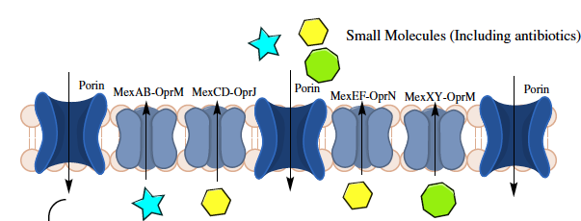
Influx/Efflux Mutants
OprD is the most prevalent mechanism for carbapenem resistance in P. aeruginosa
P. aeruginosa with reduced OprD protein expression exhibit moderate resistance to imipenem
Efflux pump overexpression combined with loss of OprD renders P. aeruginosa highly resistant to all carbapenems

Slide 66
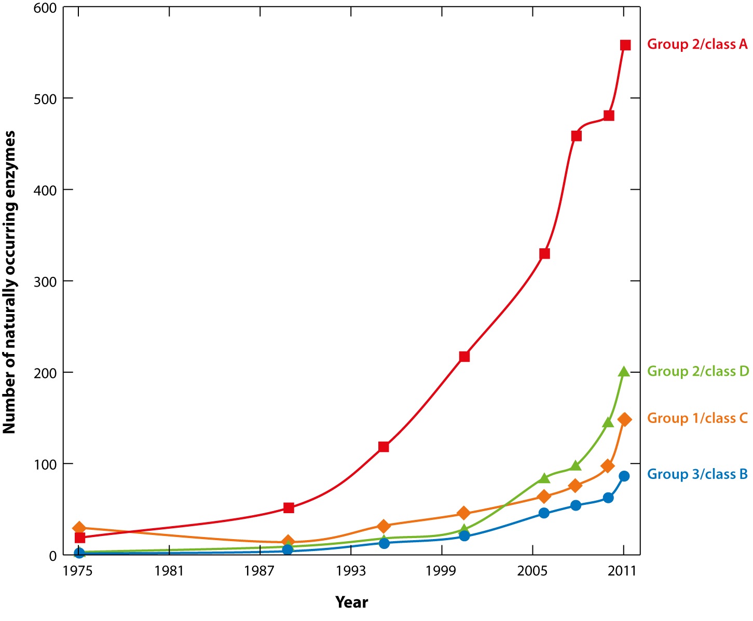


Slide 67
Ambler Classification of β-lactamases
Ambler Class
A
B
C
D
Active Site
Serine
Metallo
(zinc-binding thiol)
Serine
Serine
Enzyme Type
TEM, SHV, CTX-M, KPC
NMD-1, IMP, VIM
AmpC, CMY
OXA
Host Organisms
Enterobacteriaceae and
Non-fermenters
Enterobacteriaceae and
Non-fermenters
Enterobacter spp.
Citrobater spp.
Enterobacteriaceae and
Non-fermenters
Substrates
Ampicillin; cephalotin; penicillins; 3rd gen cephalosporins; Extended-spectrum cephalosporins; carbapenems
Cephamycins; 3rd-generation cephalosporins
Cloxacillin; Extended-spectrum cephalosporins; carbapenems
All β-lactams
KPC-2 is the most prevalent class A carbapenemase in the world and can hydrolyze the β-lactamase inhibitors clavulanic acid, sulbactam, and tazobactam.
Curcio D. 2014. Current Clinical Pharmacology. 9; 1: 27-38

Slide 68
Gram-Negative Resistance:
Four Major Areas of Need
Resistant Gram-negative Phenotype | CDC Threat Level | Estimated Cases & Attributable Deaths in US per Year
ESBL-producing Enterobacteriaceae | Serious | 26,000 cases 1,700 deaths
MDR P. aeruginosa | Serious | 6,000 cases 400 deaths
Carbapenem-resistant Enterobacteriaceae (e.g. KPC) | Urgent | 9,300 cases 610 deaths
Metallo-β-lactamase-producers | N/A | Very rare
CDC, Antibiotic Resistance Threats in the US, 2013.

Slide 69
Ceftolozane/Tazobactam
Superior antipseudomonal activity compared to ceftazidime
Active against most ESBL and Amp C-producing organisms
This material was prepared by David L Patterson and available at
/www.asid.net.au/documents/item/65

Slide 70
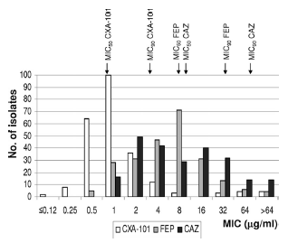
Activity of CTOL, CAZ,and FEP Against Carbapenem Resistant Pseudomonas aeruginosa
Juan C, et al: Antimicrobial Agents And Chemotherapy, 2010, 54:846–851

Slide 71
Activity of CTOL/TAZ vs. ESBLs
Covers most ESBL-producing E. coli, Klebsiella pneumoniae, and other Enterobacteriaceae
Covers most AmpC producers
Does not have activity against KPC or MBLs

Slide 72
In 2013, the Centers for Disease Control and Prevention identified CRE as “nightmare bacteria” and an immediate public health threat that requires “urgent and aggressive action.”

Slide 73
The Threat to Empiric Carbapenem Usage in Hospital-Acquired Infections
Type | Ambler Class/Example | Characterisitics | Common bacteria containing this class
Serine carbapenemases | A/KPC | Hydrolyze carbapenems KPCs | E. coli, Klebsiella spp
Metallo- β-lactamases | B/NDM-1 | Hydrolyze carbapenems | E. coli, Klebsiella spp
Cehpalosporinases | C/AmpC | Hydrolyze carbapenems | E. coli, Enterobacter spp, Citrobacter spp, P. aeruginosa, Acinetobacter
OXA | D | Hydrolyze oxacillin, oximino β-lactams and carbapenems | Acinetobacter, Enterobacteriaceae
Notes:
With some exceptions (TEM), all class A enzymes are inhibited in varying degrees by clav, sulbac, tazo
Class B enzymes are not inhibited by commercially available inibotrs
Class C: inhibitors minimally active
avibactam inhibits the activity of Ambler class A (eg, ESBL and KPC), class C (eg, AmpC), and some class D (eg, OXA-48) enzymes.22,23,40,48 It is not active against metallo-β-lactamases (eg, NDM, VIM, IMP, VEB, PER) due to the absence of the active-site serine residue or against Acinetobacter OXA-type carbapenemases
All class B (metallo-) β-lactamases are uninhibited by avibactam, and the majority of OXA enzymes are also unaffected by the addition of the drug.46
Given the widespread dissemination of such enzymes on plasmids present in Enterobacteriaceae,42 these enzymes and their spread remain the primary threat to the clinical use of ceftazidime–avibactam. Although enzymes such as SPM, GIM, and SIM have remained relatively isolated, there are increasing reports of the global emergence of plasmid-associated VIM, IMP, and NDM carbapenemases that are invariably active against ceftazidime–avibactam

Slide 74
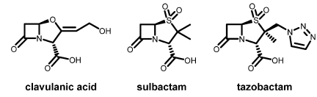
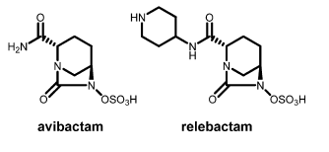

Currently Available β-lactamase Inhibitors
clavulanic acid
sulbactam
tazobactam
Inhibit some Class A beta-lactamases
avibactam
relebactam
RXP7009
Inhibit Class A and C beta-lactamases (e.g., ESBLs, KPC, ampC)
Variable Class D inhibition; no Class B (metallo beta-lactamase) inhibition

Slide 75
The Virtues of Avibactam
Avibactam inactivates most important β-lactamases except metallo types and Acinetobacter OXA carbapenemases
Even metalloenzymes can be overcome by combining avibactam with aztreonam, which is stable to metallo- β-lactamases, but vulnerable to the ESBLs and AmpC enzymes that often accompany them

Slide 76
Activity of CAZ/AVI against ESBLs
Activity against ESBLs and some carbapenem resistant Enterobacteriaceae
Most KPC producers are susceptibile
Strains with OXA-48 are susceptible
Strains which are carbapenem resistant due to porin loss plus production of an ESBL or AmpC are susceptible
Antimicrob. Chemother. (2012) 67: 1354-1358.
Livermore AAC 2015; 55: 390-394

Slide 77
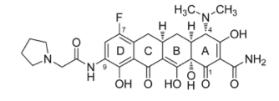
Eravacycline:
A Fluorotetracycline
Fully synthetic fluorocycline with broad spectrum activity including MDR Gram-positive, Gram-negative, and anaerobic organisms (excepting Pseudomonas)
Highly active against Enterobacteriaceae harboring ESBLs and carbapenemases
Activity against isolates containing tetracycline-specific efflux and ribosomal protection mechanisms
High bioavailability in oral formulations
Effective in cUTIs and in cIAI (Phase 2 and 3)
Notes:
IV and oral opportunities…..

Slide 78
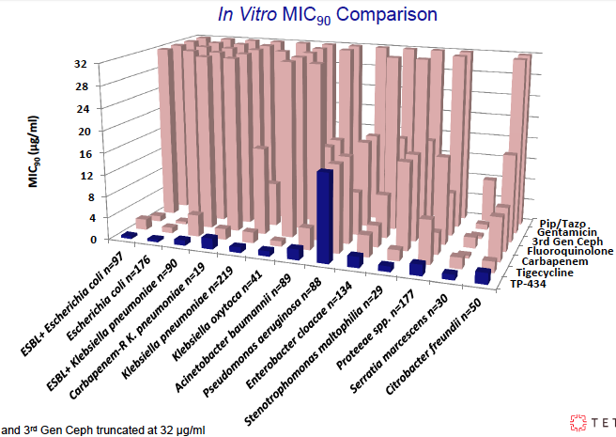
Broad Spectrum Against Gram-Negative Pathogens

Slide 79
Plazomicin (ACHN-490, Achaogen)
Aminoglycoside, IV only
  A chemical modificaion of sisomicin
Gram-negative spectrum
  Bactericidal
SPA for Phase 3 clinical trial to evaluate efficacy and safety of plazomicin compared with colistin for infections caused by CRE 09/2013
Phase 3 vs. colistin for the treatment of patients with bloodstream infection (BSI) or nosocomial pneumonia due to CRE initiated 2/21/14
www.clinicaltrials.gov; www.achaogen.com

Slide 80
Antibacterials in Phase 2 Development
Drug Name (Company) | Class | Active vs Gram-negative Pathogens | Potential Indications
POL7080 (Polyphor/Roche) | Macrolide LptD inhibitor | Yes (Pseudomonas) | VABP, bronchiectasis
Debio 1452 (Debiopharm Group) | Fabl Inhibitor | No | ABSSSI
CG-400549 (CrystalGenomics) | Fabl Inhibitor | No | ABSSSI
Brilacidin (Cellceutix) | Defensin-mimetic | No | ABSSSI
Ceftaroline-avibactam (AZ/Actavis) | Cepalo + BLI | Yes | cUTI
Radezolid (Melinta) | Oxazolidinone | Yes | ABSSSI, CAPB
TAKSTA (fusidic acid, Cempra) | Fusidane | No | PJI
TD-1792 (Theravance) | Glycopeptide-cephalosporin heterodimer | No | ABSSSI, HABP/VABP
Nemonoxacin (TiaGen Biotech) | Quinolone | Yes | CABP, DFI, ABSSSI
Finafloxacin (MerLion Pharmaceuticals) | Fluoroquinolone | Yes | cUTI, cIAI, ABSSSI
Avarofloxacin (Furiex/Actavis) | Fluoroquinolone | Yes | CABP/ABSSSI
Zalbofloxacin (Dong Wha Pharma) | Fluoroquinolone | No | CABP
GSK2140944 (GSK) | Type 2 topoisomerase inhibitor | No | ABSSSI, Resp infection, CABP
http://www.pewtrusts.org/en/research-and-analysis/issue-briefs/2014/03/12/tracking-the-pipeline-of-antibiotics-in-development
Notes:
tt

Slide 81
Conclusions
For Gram-negative pathogens, multiple mechanisms of resistance to previously useful antibiotics is becoming the norm
We now are moving to an era of carbapenem resistance, driven by influx/efflux controls and evolving ESBLs
New agents for Pseudomonas and Enterobacteriaceae offer real help
Containment should be pursued through implementation of adequate infection prevention procedures and antimicrobial stewardship to reduce the disease burden and prevent outbreaks of MDR/XDR organisms

Slide 82
Closing Reminders
As a reminder there are TWO ways to complete your Program Evaluation and receive CME/CE credit:
  1. There are instructions in the workbook on page 6 to complete the program evaluation and CME/CE form online.
  2. There is a Post Test, Program Evaluation and CME/CE form at your seat. Please complete and provide to a MedEDirect Representative as you exit.
Thank you for your participation!

