Slide 1

Characterization of the Murine Septic Response Using Wireless Telemetry Technology:
Modeling the Murine 9-1-1
Anthony J. Lewis, MD
Christopher W. Seymour, MD MS
Du Yuan
Xianghong Zhang, PhD
Matthew R. Rosengart, MD MPH
Departments of Surgery & Critical Care Medicine
18 April 2015
Notes:
Instructions for editing school and department titles:
Select from menu: View > Master > Slide Master
Click on each text area you wish to edit. Text will become editable.

Slide 2
A problem that needs no introduction…
Angus et al. (2001): over 750,000 hospital admissions for sepsis in US annually¹
20+ % mortality
Death rate equivalent to deaths from acute MI
Over 60+ therapeutic trials in 30 years²
Benefit of early goal-directed therapy (2001)
ProCESS, ARISE, ProMISe trials casting doubt on mainstays of sepsis therapy

Slide 3
Antibiotics
Fluid Resuscitation
They work.
How quick is ‘quick enough’?

Slide 4
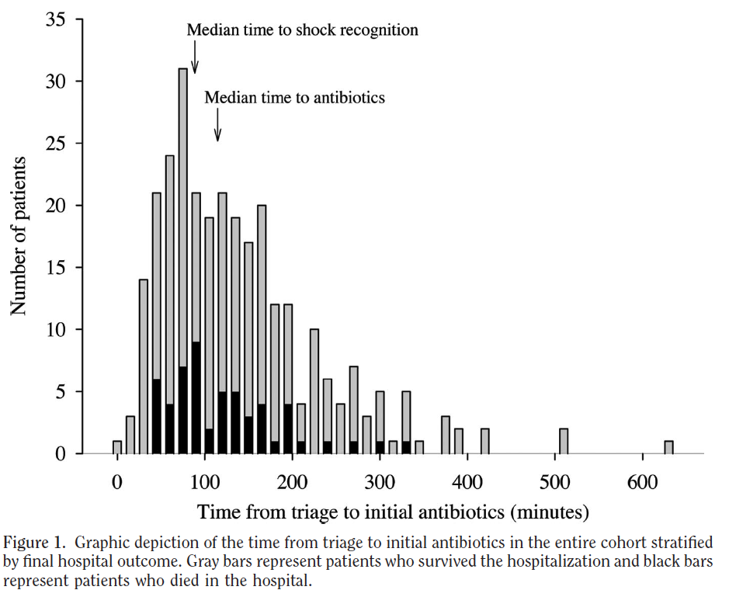
Time to Antibiotics

Slide 5
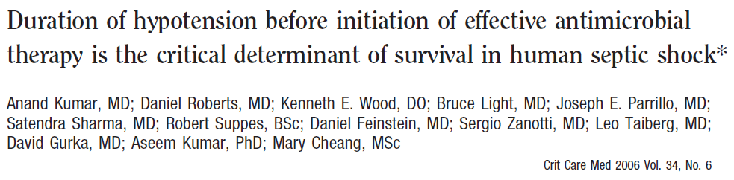
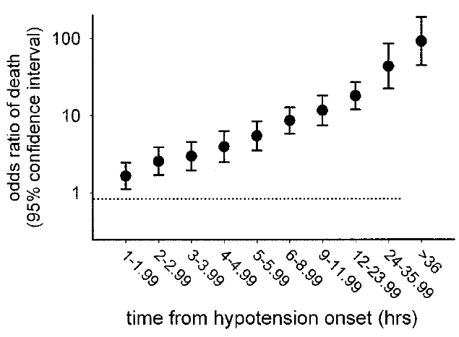
Median time to antibiotic therapy was 6 hours after recognition of shock
Mortality increased 7.6% for every hour delay after onset of hypotension
Starting antibiotics within the first hour: 79.9% survival to discharge
Starting antibiotics after six hours: 42% survival to discharge

Slide 6
Prehospital Care

Slide 7
EMS Care
Time sensitive conditions: trauma, ACS, stroke
Care is initiated in the ambulance per protocol
Advanced capabilities: endotracheal intubation, mechanical ventilation, vasopressors, neuromuscular blockade, anti-arrhythmics, ACLS

Slide 8
EMS and Sepsis
Sepsis encountered twice as often as myocardial infarction
Fewer than 1/3 get an intravenous catheter prehospital
Less than 25% get IV fluids
Prehospital fluid administration was associated with a 55% reduction in odds of hospital mortality

Slide 9
Interim Summary
Protocols for sepsis treatment are effective and time-sensitive
Sepsis is frequently encountered by EMS
Opportunities exists to develop protocols
  Fluids, antibiotics
Up to 2 hour lead time possible on antibiotic initiation
Significant room for improvement regarding IV fluids

Slide 10
Prior to embarking on an RCT of prehospital sepsis care, it would be nice to have data supporting that such an incremental reduction in time of administration of fluids and antibiotics matters.

Slide 11
Development of a Relevant Animal Model
Current models use fixed time intervals after septic insult to test therapy
Host response is widely variable both in temporality and magnitude¹
Human sepsis treatment is prompted by physiologic changes, not time → the “9-1-1” call

Slide 12
Aim #1: Determine the temporal changes in clinical and biologic parameters that correlate with acute deterioration in a murine model of sepsis.

Slide 13
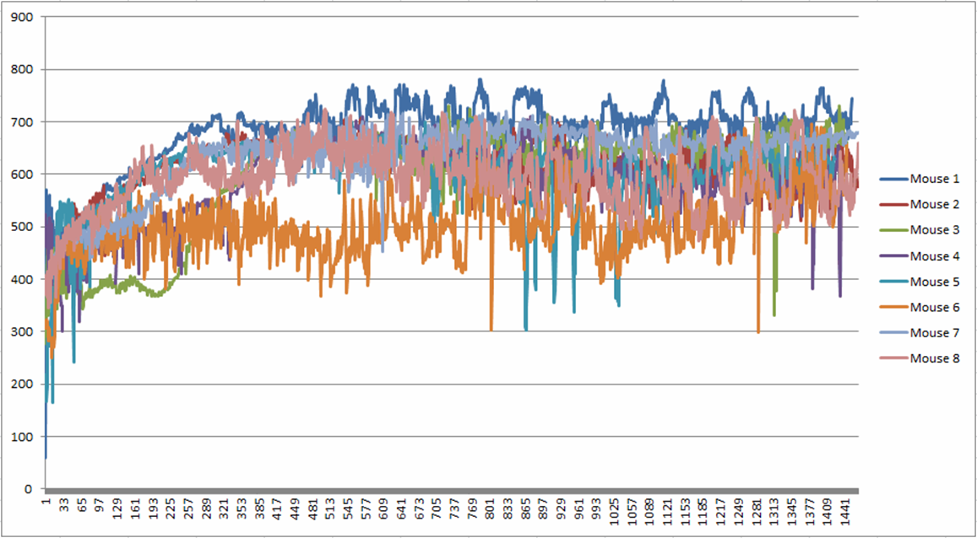
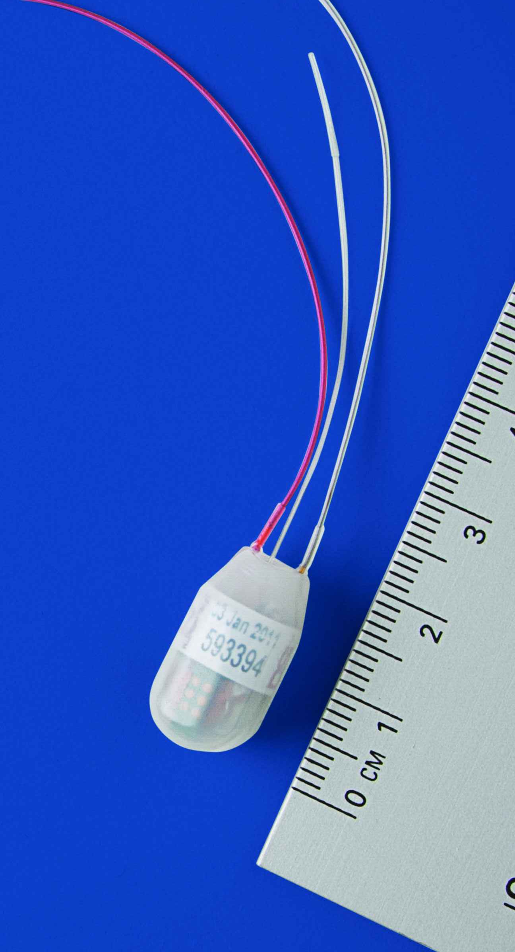
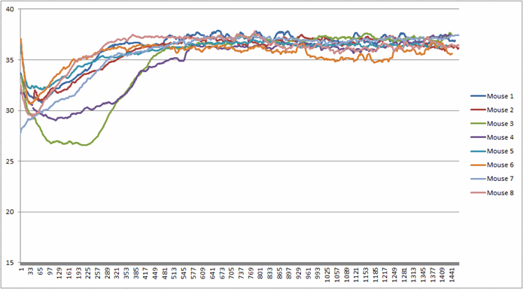
DSI HD-X11
Heart Rate
Implantable telemetry
Wireless monitoring
Continuous measurement of ECG, blood pressure, core temperature, and animal activity
2 grams
1.4 cc in volume
Core Temperature

Slide 14
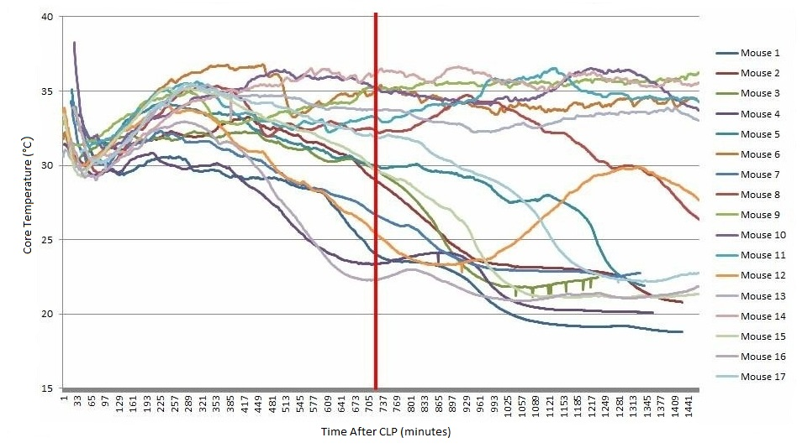
Aggregate Data – 24 hours, CLP, No treatment
Core Temperature
14 degree difference at 12 hours

Slide 15
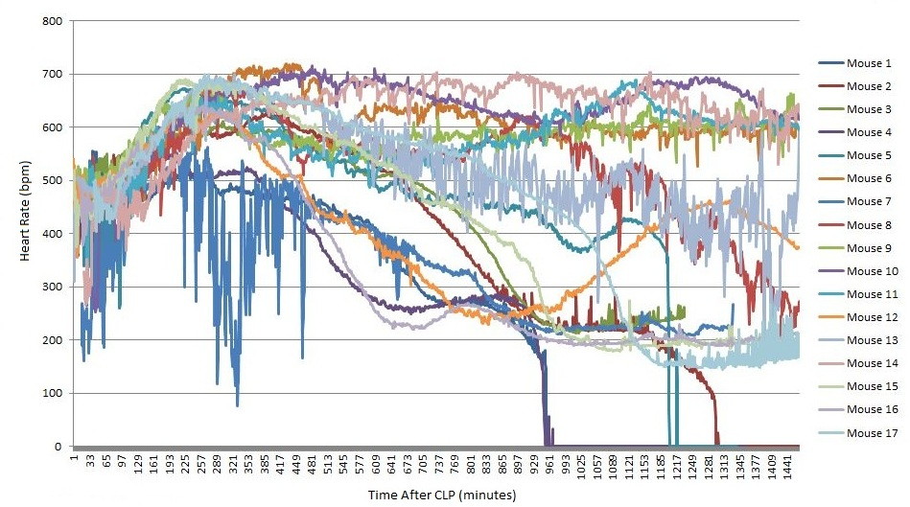
Aggregate Data – 24 hours, CLP, No treatment
Heart Rate
Considerable heterogeneity in physiologic trajectory

Slide 16
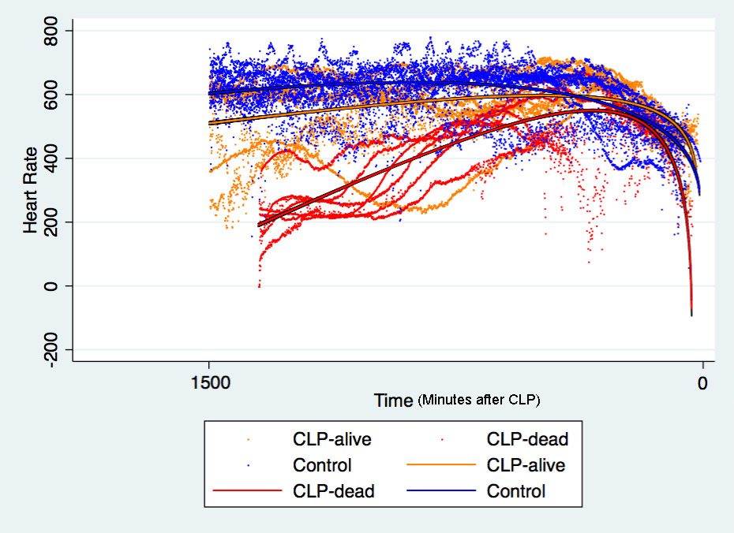
Data Modeling: Heart Rate zeroed on death or last point of observation

Slide 17
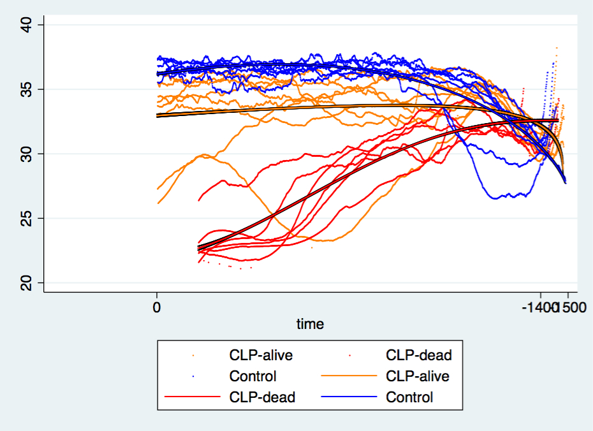
Data Modeling: Temperature zeroed on death or last point of observation

Slide 18
Defining Deterioration Thresholds
Wide heterogeneity in the onset and magnitude of sick response
Need standardized approach to define point of deterioration or the “mouse 9-1-1 call” in order to test future interventions
Currently testing thresholds based on bradycardic/hypothermic physiology observed in septic mice
  HR decline by 10% off peak HR and core temperature decline by 10% x (peak temp. - 25°C)

Slide 19
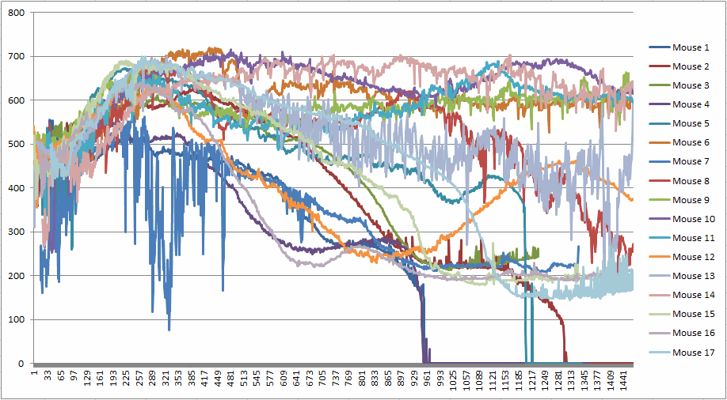
Thresholds
12 hours
Range of meeting physiologic threshold in original descriptive cohort:
356-1344 minutes post-CLP
6 hours

Slide 20
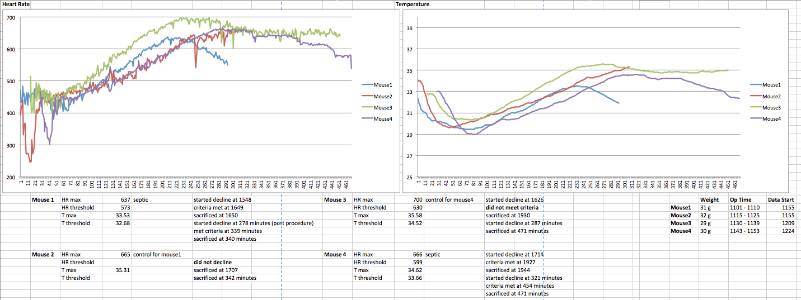
9-1-1

Slide 21
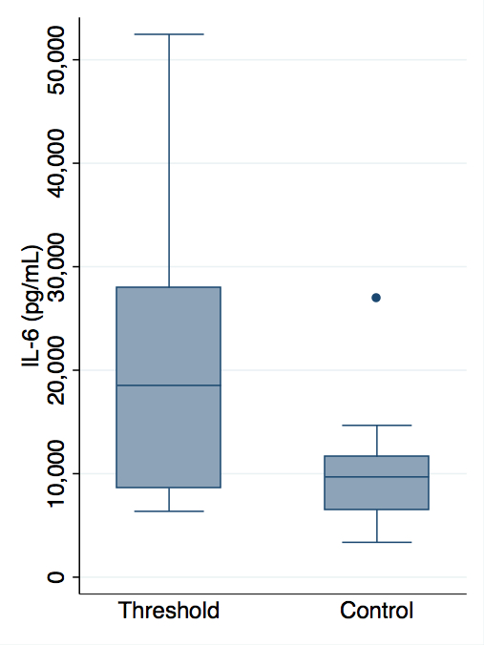
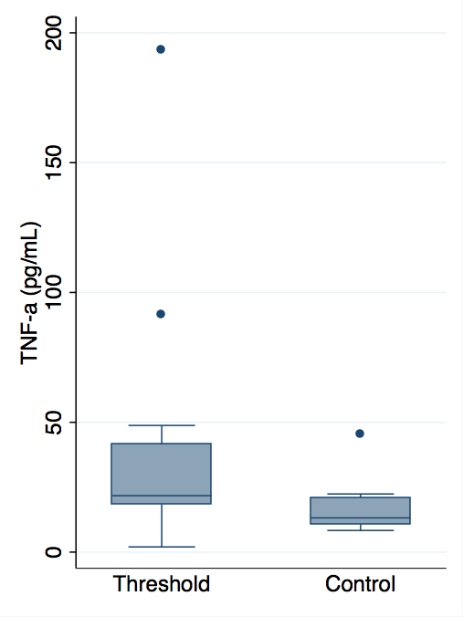
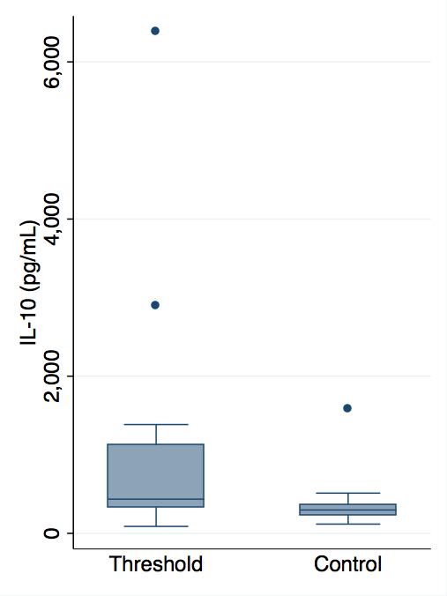
Thresholds: Inflammation
p = 0.03
p = 0.03
p = 0.03
IL-6 (pg/mL)
TNF-α (pg/mL)
IL-10 (pg/mL)

Slide 22
Thresholds: Mixed Venous Blood Gas
pH
Base Excess
HCO₃⁻
p < 0.05 for all parameters

Slide 23
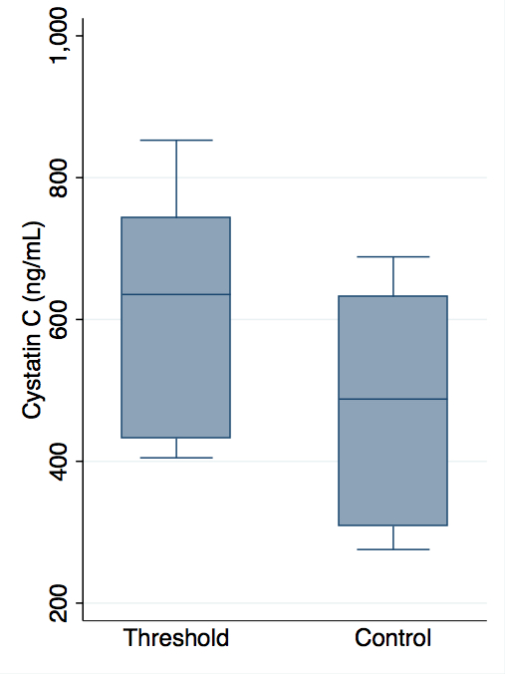
Thresholds: Acute Kidney Injury
p = 0.09

Slide 24
Future Directions

Slide 25
Aim #2: Determine the effect of administering fluid resuscitation and/or antibiotic treatment at acute deterioration vs. after a 2-hr delay in a murine model of sepsis.

Slide 26
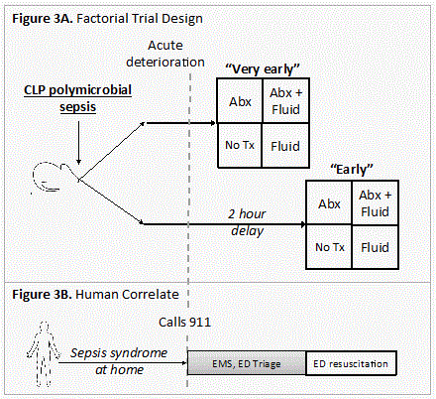
Experimental Design
Based upon data from Aim #1, we will recognize acute deterioration corresponding to the mouse “9-1-1” call
Interventions will be antibiotics alone, IV fluid alone, combination antibiotics and IV fluid, or no treatment (control)
Interventions will be “very early” (time of deterioration) or “early” (2 hour delay)

Slide 27
Analysis of results
Overall effect on mortality
Measurement of biomarkers
  IL-6, IL-10, TNF-α, lactate
Measure effects on organ function
  Cystatin C, alanine aminotransferase (ALT)
Return to physiologic normal range
Return of animal foraging activity

Slide 28
Acknowledgments
Matthew Rosengart, MD MPH
Christopher Seymour, MD MSc
Timothy Billiar, MD
Du Yuan
Xianghong Zhang, PhD
Surgical Infection Society
SIS Foundation

